Slide 1

Introduction to OpenMP
Part4. Advanced Topics
人工智能学院
缪青海
miaoqh@ucas.ac.cn

Slide 2
Content
Getting started with OpenMP
Core features of OpenMP
Work with OpenMP
Advanced topics of OpenMP

Slide 3
Advances of OpenMP
Tasks for linked list
Monte Carlo Calculations
Parallel Patterns

Slide 4
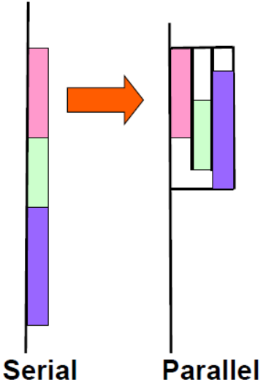
OpenMP Tasks
Tasks：are independent units of work.
Tasks 的组成:
  – code to execute
  – data environment
  – internal control variables (ICV)
Task的工作由线程来执行.
when tasks are executed？
  由运行时系统（runtime system）决定：
  – Tasks may be deferred
  – Tasks may be executed immediately

Slide 5
Task Definitions
Task construct
  – task directive plus structured block
Task
  – the package of code and instructions for allocating data created when a thread encounters a task construct
Task region
  – the dynamic sequence of instructions produced by the execution of a task by a thread

Slide 6
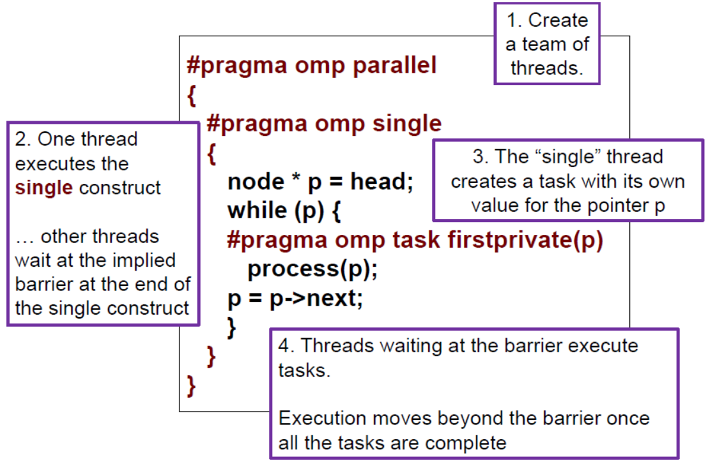
Task Construct – Explicit Tasks

Slide 7
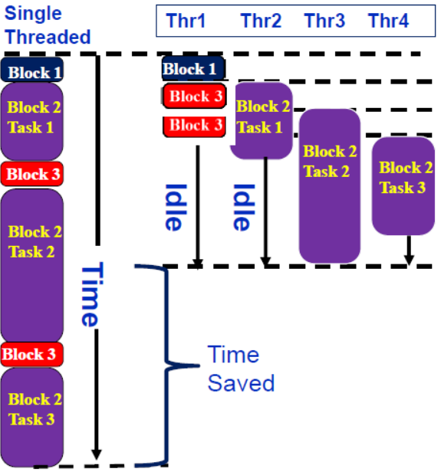
Execution of tasks
Have potential to parallelize irregular patterns and recursive function calls
#pragma omp parallel
{
  #pragma omp single
  { //block 1
    node * p = head;
    while (p) { // block 2
    #pragma omp task
    process(p);
    p = p->next; //block 3
    }
  }
}

Slide 8
When tasks completed?
Tasks are guaranteed to be complete at thread barriers:
  #pragma omp barrier
or task barriers
  #pragma omp taskwait
Multiple foo tasks created
here – one for each thread
#pragma omp parallel
{
  #pragma omp task
  foo();
  #pragma omp barrier
  #pragma omp single
  {
  #pragma omp task
  bar();
  }
}
All foo tasks guaranteed to
be completed here
One bar task created here
bar task guaranteed to be
completed here

Slide 9
Data Scoping with tasks
Fibonacci example:
  The divide and conquer design pattern
n is private in both tasks
int fib ( int n )
{
  int x,y;
  if ( n < 2 ) return n;
  #pragma omp task
  x = fib(n-1);
  #pragma omp task
  y = fib(n-2);
  #pragma omp taskwait
  return x+y
}
x is a private variable
y is a private variable
What’s wrong here?
A task’s private variables are undefined outside the task

Slide 10
Data Scoping with tasks
Fibonacci example:
  The divide and conquer design pattern
n is private in both tasks
int fib ( int n )
{
  int x,y;
  if ( n < 2 ) return n;
  #pragma omp task shared (x)
  x = fib(n-1);
  #pragma omp task shared (y)
  y = fib(n-2);
  #pragma omp taskwait
  return x+y
}
x & y are shared
Good solution
we need both values to compute the sum

Slide 11
Data Scoping with tasks
List Traversal example:
What’s wrong here?
List ml; //my_list
Element *e;
#pragma omp parallel
#pragma omp single
{
  for(e=ml->first;e;e=e->next)
  #pragma omp task
  process(e);
}
Possible data race !
Shared variable e
updated by multiple tasks

Slide 12
Data Scoping with tasks
List Traversal example:
What’s wrong here?
List ml; //my_list
Element *e;
#pragma omp parallel
#pragma omp single
{
  for(e=ml->first;e;e=e->next)
  #pragma omp task firstprivate(e)
  process(e);
}
Good solution
– e is firstprivate

Slide 13
Test2-2: tasks in OpenMP
Consider the program linked.c
  遍历一个链表，在每个节点计算一系列斐波那契数。
Parallelize this program using tasks.
  比较前（ without tasks ）、后（using tasks）两种实现方法的复杂程度.
Code:
  test2_Fibonacci/solutions/linked_omp3_tasks.c

Slide 14
Advances of OpenMP
Tasks for linked list
Monte Carlo Calculations
Parallel Patterns

Slide 15
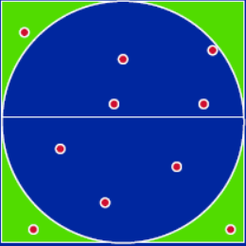
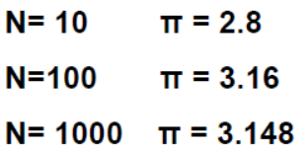
Monte Carlo Calculations
Monte Carlo Method:
  使用随机数解决复杂问题
  对问题域进行抽样以估计面积、计算概率、寻找最优值等。
Example: 用数字飞镖靶盘计算 π :

Slide 16
Monte Carlo Calculations:
向靶盘（circle/square）投飞镖，
落入圆圈内的概率与面积比成正比：
  Ac = π * r²
  As = (2*r) * (2*r) = 4 * r²
  P = Ac/As = π /4
通过随机选择点，计算落在圆内的点的比例，从而计算π。
Code: test3_Pi_mc/pi_mc.c 串行代码

Slide 17
Monte Carlo Calculations:
并行程序员喜欢蒙特卡洛算法：
Embarrassingly parallel:
  the parallelism is so easy its embarrassing.
只需要添加两行代码就可以实现并行化，但需要一个随机数生成器.
Code: test3_Pi_mc/solutions/pi_mc_par.c 并行代码

Slide 18
Linear Congruential Generator (LCG)
LCG: Easy to write, cheap to compute, portable, OK quality.
LCG 是伪随机序列生成器，周期PMOD，与参数multiplier 和 addend 有关.
选择好的LCG 参数比较复杂，使用如下组合 :
  􀂋 MULTIPLIER = 1366
  􀂋 ADDEND = 150889
  􀂋 PMOD = 714025
Code: test3_Pi_mc/solutions/random_seq_lcg.c
compile: gcc –fopenmp pi_mc_par.c random_seq_lcg.c
线性同余

Slide 19
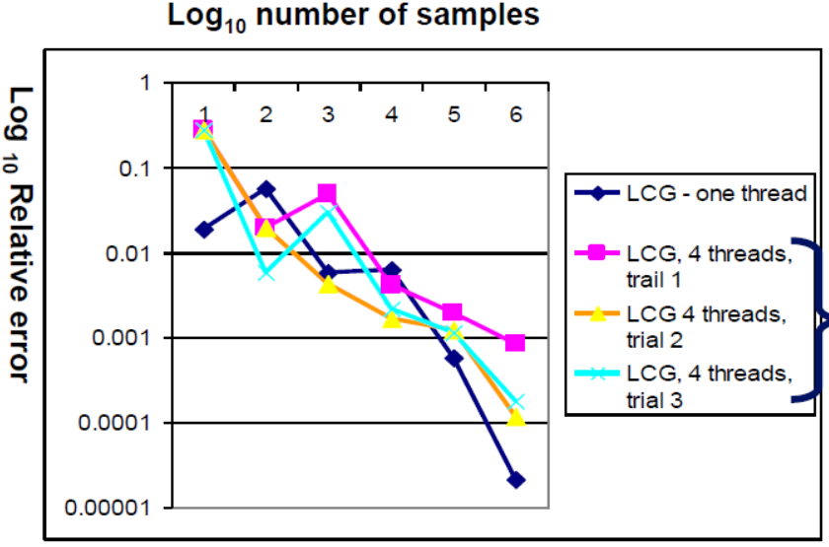
PI_MC with LCG generator
Problem：
  以相同的方式运行相同的程序，却得到不同的结果！
  这是不可接受的！
Issue:
  the LCG generator is not threadsafe
  线程安全问题

Slide 20
LCG code: threadsafe version
  static long MULTIPLIER = 1366;
  static long ADDEND = 150889;
  static long PMOD = 714025;
  long random_last = 0;
  #pragma omp threadprivate(random_last)
  double random ()
  {
  long random_next;
  random_next = (MULTIPLIER * random_last + ADDEND)% PMOD;
  random_last = random_next;
  return ((double)random_next/(double)PMOD);
  }
Construct (指令)
threadprivate不是针对某一个并行块，而是作用于整个程序。

Slide 21
LCG code: threadsafe version
#pragma omp threadprivate(random_last)
random_last 的值影响随机数计算。
为了使生成器线程安全，将 random_last 设置为 threadprivate，以便每个线程都有自己的副本。
Code:
  test3_Pi_mc/solutions/random_par.c
  compile: gcc –fopenmp pi_mc_par.c random_par.c

Slide 22
Data sharing: Threadprivate
将全局数据设置为线程私有
  C: 文件作用域和静态变量，静态类成员
与将它们设置为 PRIVATE 区别
  PRIVATE， 全局变量在并行区域内被屏蔽。
  THREADPRIVATE， 在每个线程内保留全局作用域。
Threadprivate 变量可以使用 COPYIN 初始化，或在定义时初始化（使用语言定义的初始化能力）。

Slide 23
A threadprivate example
使用threadprivate 为每一个线程创建一个计数器counter.
int counter = 0;
#pragma omp threadprivate(counter)
int increment_counter()
{
  counter++;
  return (counter);
}

Slide 24
A threadprivate example
#pragma omp parallel
{
int count;
#pragma omp single copyprivate(counter)
{
counter = 50;
}
count = increment_counter();
printf("ThreadId: %ld, count = %ld/n", mp_get_thread_num(), count);
}
Copyprivate():
  将一个值从一个隐式任务的数据环境中广播到属于并行区域的其他隐式任务的数据环境中。

Slide 25
Thread safe random number generators
test3_Pi_mc：
  线程安全的版本每次运行程序时都会给出相同的结果。
但对于大量采样的计算，其质量低于单线程结果！
Why?

Slide 26
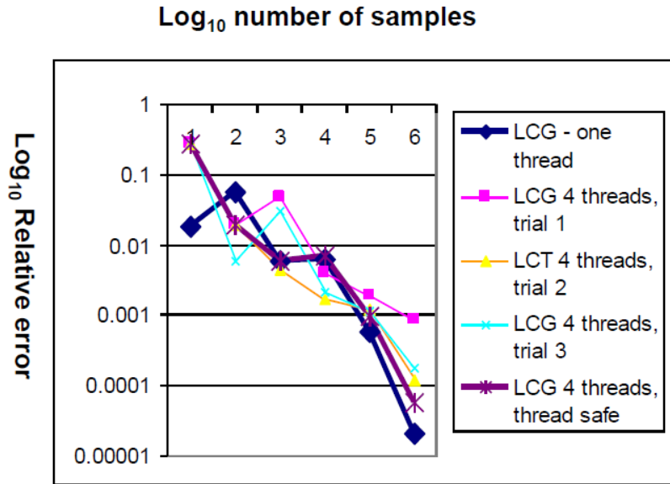
Thread safe random number generators
Thread safe version gives the same answer each time you run the program.
But for large number of samples, its quality is lower than the one thread result!
Why?

Slide 27
Pseudo Random Sequences
随机数生成器Random number Generators (RNGs) 定义了一个伪随机数序列，其长度等于RNG的周期。
在典型的问题中，获取RNG范围的一个子序列。
如果随意选取种子，可能会生成重叠的序列。
重叠序列意味着：过度采样和糟糕的统计……质量降低甚至可能得到错误的结果！

Slide 28
Parallel random number generators
多个线程应合作生成和使用随机数。
解决方案：
  1. 给每个线程一个独立的生成器。
  2. 让一个线程生成所有数字。
  3. 跳蛙法……像发牌一样“轮流”分配序列值。
  4. 区块方法……选择合适的种子，使得每个线程获得一个不同的连续区块。
OR… use/buy a math library that does it right.

Slide 29
Advances of OpenMP
Tasks for linked list
Monte Carlo Calculations
Parallel Patterns

Slide 30
Summary of OpenMP
Parallel Patterns:
  SPMD: Single Program Multiple Data
  Loop parallelism
  Divide and Conquer
  ……

Slide 31
Parallel Patterns
SPMD:
  在P个处理单元上运行相同的程序；
  使用rank……一个从0到(P-1)的ID……来选择一组任务中的一个。
  这是并行编程历史上最常用的模式。
  Example : computing Pi

Slide 32
#include <omp.h>
void main (int argc, char *argv[])
{
  int i, pi=0.0, step, sum = 0.0;
  step = 1.0/(double) num_steps;
  #pragma omp parallel firstprivate(sum) private(x, i)
  {
  int id = omp_get_thread_num();
  int numprocs= omp_get_num_threads();
  int step1 = id *num_steps/numprocs;
  int stepN = (id+1)*num_steps/numprocs;
  if (stepN! = num_steps) stepN= num_steps;
  for (i=step1; i<stepN; i++){
  x = (i+0.5)*step;
  sum += 4.0/(1.0+x*x);
  }
  #pragma omp critical
  pi += sum *step ;
  }
}
SPMD

Slide 33
Parallel Patterns
Loop parallelism:
  任务集合是循环迭代loops of iterations形式；
  循环迭代被分配给一组处理单元。
  数据并行设计模式中被大量使用；
  通常被OpenMP程序员使用。
  Example : computing Pi

Slide 34
#include <omp.h>
static long num_steps= 100000;
double step;
#define NUM_THREADS 2
void main ()
{
  Int i; double x, pi, sum =0.0;
  step = 1.0/(double) num_steps;
  omp_set_num_threads(NUM_THREADS);
  #pragma omp parallel for private(x) reduction (+:sum)
    for (i=0; I < num_steps; i++){
    x = (i+0.5)*step;
    sum += 4.0/(1.0+x*x);
    }
  pi = sum * step;
}
LOOP

Slide 35
Parallel Patterns
Divide and Conquer:
  将问题分解为子问题；
  并行计算子问题；
  将子问题的解决方案重新组合成全局解决方案。
  Example : computing Pi

Slide 36
#include <omp.h>
static long num_steps= 100000000;
#define MIN_BLK 10000000
double pi_comp(int Nstart, int Nfinish, double step){
  Int i, iblk; double x, sum = 0.0, sum1, sum2;
  if (Nfinish-Nstart< MIN_BLK){
    for (i=Nstart; i< Nfinish; i++){
    x = (i+0.5)*step;
    sum = sum + 4.0/(1.0+x*x);
    }
  }
  else{
    iblk= Nfinish-Nstart;
    #pragma omp task shared(sum1)
    sum1 = pi_comp(Nstart, Nfinish-iblk/2, step);
    #pragma omp task shared(sum2)
    sum2 = pi_comp(Nfinish-iblk/2, Nfinish, step);
    #pragma omp taskwait
    sum = sum1 + sum2;
  }
  return sum;
}
Divide and Conquer
int main (){
inti;double step, pi, sum;
step = 1.0/(double) num_steps;
#pragma omp parallel {
#pragma omp single
sum=pi_comp(0,num_steps,step);
}
pi = step * sum;
}

Slide 37
Advances of OpenMP
More topics
  Memory model
  Teams
  Distributed SIMD
  Pairwise Synchronization
  ……

Slide 38
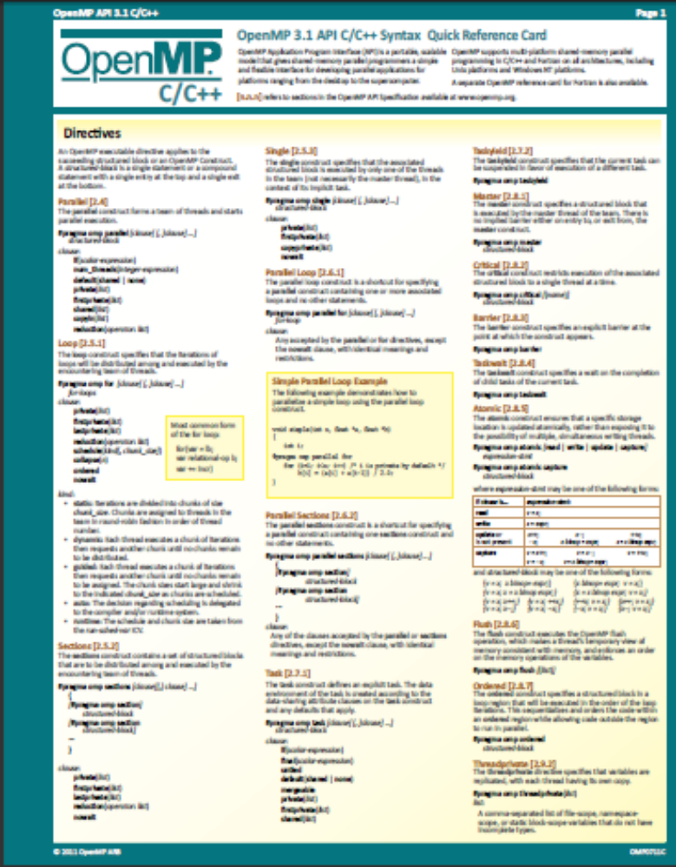
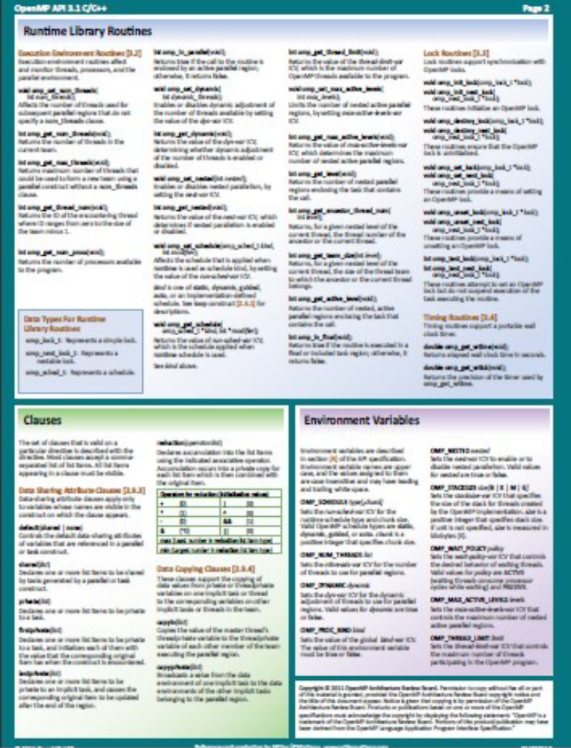
https://www.openmp.org/specifications/

Slide 39
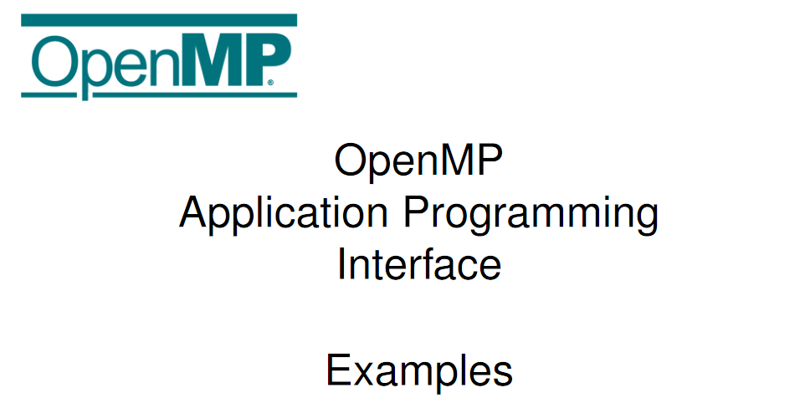
Supplementary Source Code – GitHub Repository
OpenMP 5.2.1 Examples – Nov 2022
OpenMP 5.2 Examples Discussion Forum

Slide 40
references
https://www.openmp.org
Tim Mattson, A “Hands-on” Introduction to OpenMP, Intel Corp.
Mark Bull, Parallel Programming with OpenMP, EPCC, University of Edinburgh, UK.
迟学斌等，并行计算与实现技术，科学出版社。

